Slide 1
Estimation of Hb in blood and ABO blood group typing Points to be discussed in the current experiment
Role of blood as principle transport medium and its normal oxygen carrying capacity without any accessory protein.
Hemoglobin as an important respiratory pigment and increase of oxygen carrying capacity in its presence.
Normal level of Hb in blood in males and females
Details of Sahli’s Hemometer, Hematin formation
RBC ag (agglutinogen) & plasma antibodies
Hemagglutination reaction
Physiological effect of transfusing mismatched blood
Role in blood transfusion
Information on donor & recipients of blood transfusion
Rh Factor: Role in blood transfusion & Erythroblastosis fetalis
Procedure for Hb estimation & Blood group determination
Biosafety aspects of handling human blood

Slide 2
Introduction of Blood
It is a vascular tissue and fluid in nature
Principle medium of transport present through out the body of vertebrates.
It is divided into two parts:
1. Plasma (Antibodies are present in the plasma)
2.Cells are of three types: A. RBCs B. WBCs C. Platelets ( Proteins present on the surface of the RBCs decide the blood group )
Major function is the transportation of nutrient , hormone, O₂, CO₂, waste materials and maintenance of body temperature & role in immune response

Slide 3
Hemoglobin
Physically the amount of oxygen dissolved the blood is 0.2 ml/100ml of blood but it increases up to 200 times in the presence of RBCs.
It is due to the presence of a globin protein with heme (fe2+) as prosthetic group and a phorphyrin ring attached to it.
This is known as hemoglobin. It is a globular protein which has 2 α polypeptides and 2 β polypetides. In infants , instead of β polypeptides, 2 γ polypetides are present which are replaced by β polypeptides as they grow up.

Slide 4
Function of hemoglobin
Heme part presents in the hemoglobin protein makes the blood red.
It carries oxygen from lungs to different parts of body.
One molecule of hemoglobin can bind to 4 molecules of oxygen in reversible manner.
So depending upon the partial pressure of oxygen association and dissociation takes place.
Lower level of hemoglobin causes anemia.
Fe present in High iron foods include liver, sunflower seeds, nuts, beef, lamb, beans, whole grains, dark leafy greens (spinach), dark chocolate, and tofu, Fruits and green leefy vegetables, spinach, moong sprouts, etc.

Slide 5
ABO blood typing
Blood typing was discovered by Karl Landsteiner and won Nobel Prize for it. Later on Rh factor was also discovered by him
Based on the glyco-protein present on the surface of RBCs, blood group has been divided into four types.
A, B, AB and O and RhD antigen.
During blood transfusion and organ transplantation it becomes necessary to have RBCs compatibility to avoid hemolysis and subsequent complications in the organisms.

Slide 6
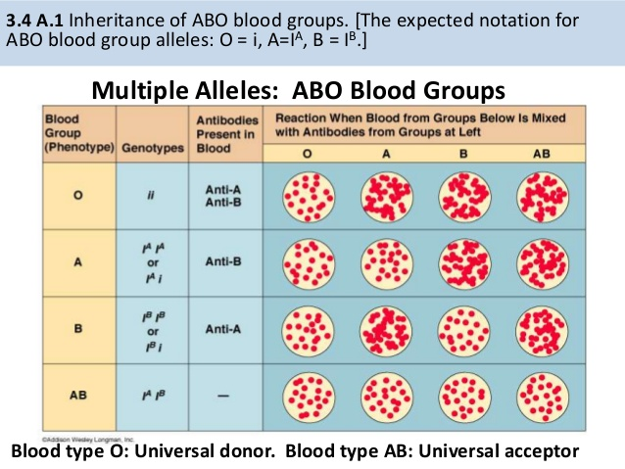
Inheritance of ABO blood groups

Slide 7
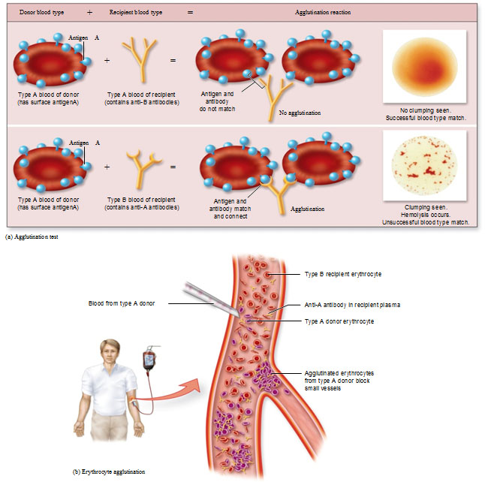
Agglutination reaction
Agglutination reaction

Slide 8
RhD antigen compatibility
Rh typing is especially important during pregnancy because a mother and her fetus could be incompatible.
If the mother is Rh-negative but the father is Rh-positive, the fetus may be positive for the Rh antigen. During delivery of the baby, the mother’s and baby’s blood can come in contact with each other and mother’s body could develop antibodies against Rh antigen.
No problem will occur during the first pregnancy but in the subsequent pregnancies, whenever the baby’s blood group is Rh +ve, the antibodies present in the mother’s body will be developed at the faster rate and after crossing the placenta, will destroy the baby’s RBC.
This condition which is hemolytic disease of the fetus is known as Erythroblastosis fetalis.
For prevention of this disease, mothers are treated with Anti AntiD to avoid any hemolysis of baby’s RBC

Slide 9
Antigen and Antibody present in blood group of individual
ABO Blood Type |  | Types of Antigens and Antibody
 |  | Antigen A | Antigen B |  | Antibody anti-A | Antibody Anti-B
A |  | yes | no |  | no | yes
B |  | no | yes |  | yes | no
O |  | no | no |  | yes | yes
AB |  | yes | yes |  | no | no

